Slide 1


Slide 2


Transcription
& Translation
Prepared By
Dr. Shuzan Ali Mohammed

Slide 3
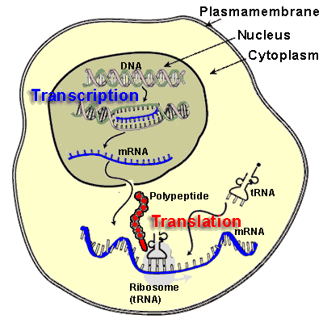

Slide 4
Transcription
(RNA synthsis)

Slide 5
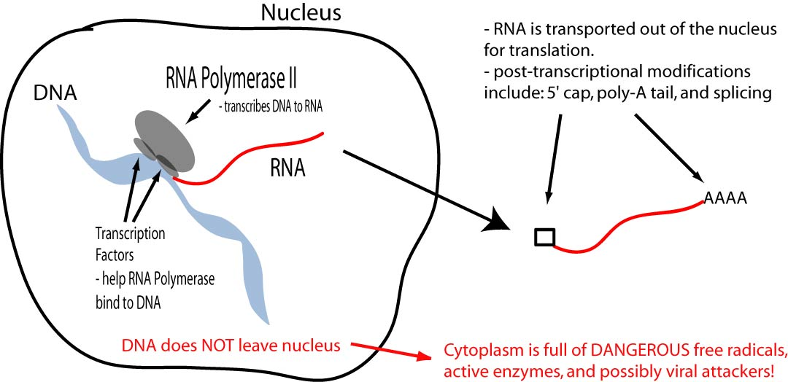

Slide 6
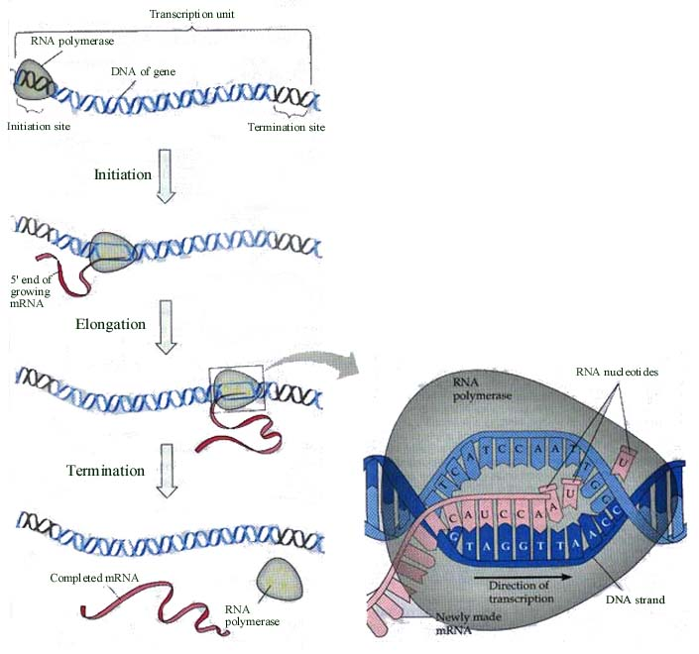

Slide 7
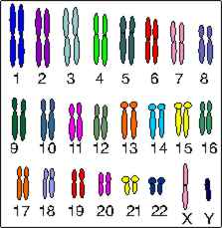

Slide 8
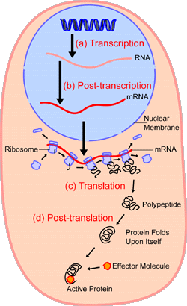

Slide 9


Slide 10
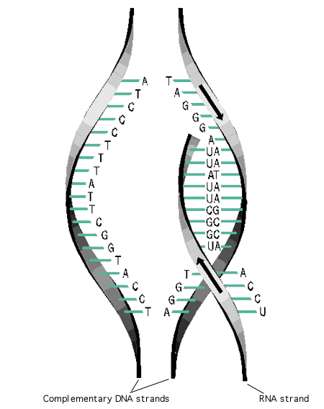

Slide 11
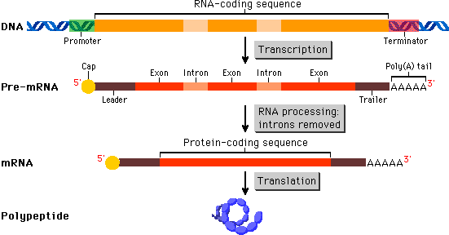

Slide 12
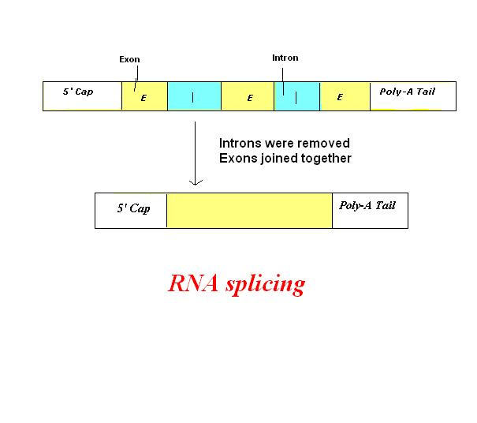

Slide 13
Translation
(protein synthesis)

Slide 15
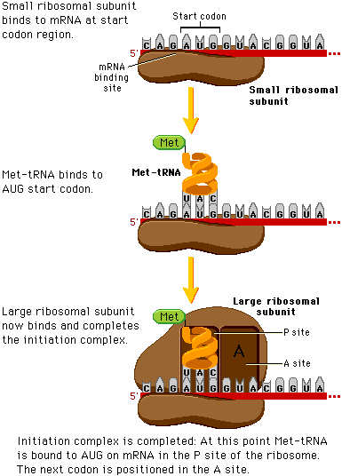

Slide 16
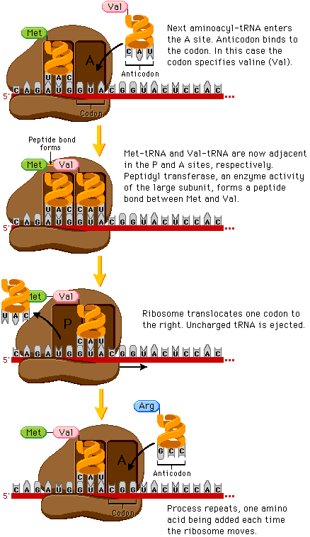
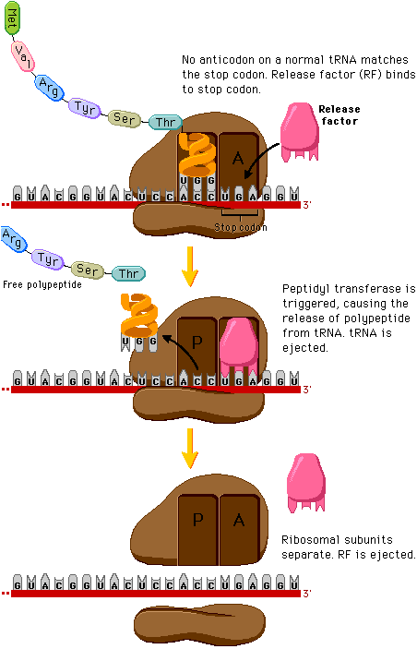

Slide 17
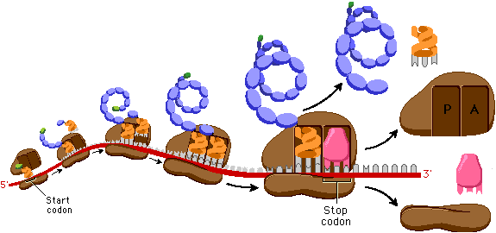

Slide 18
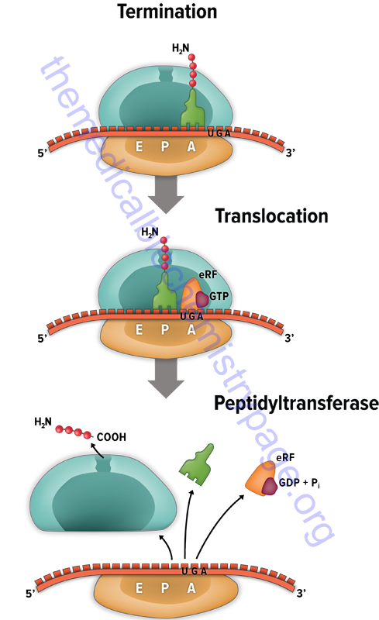

Slide 19
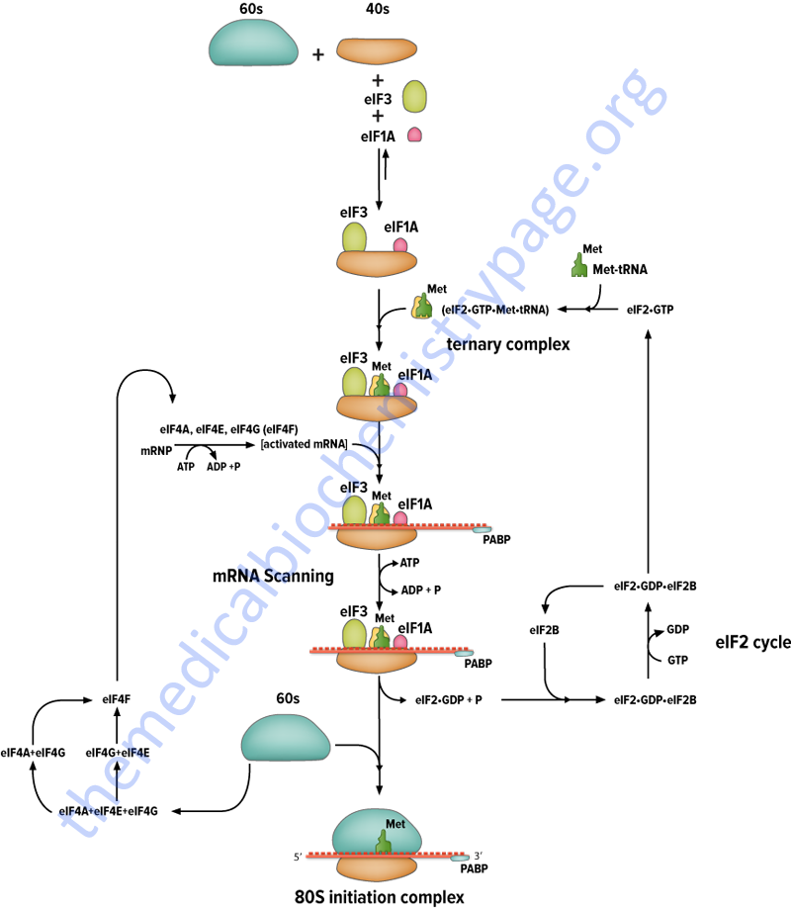

Slide 20
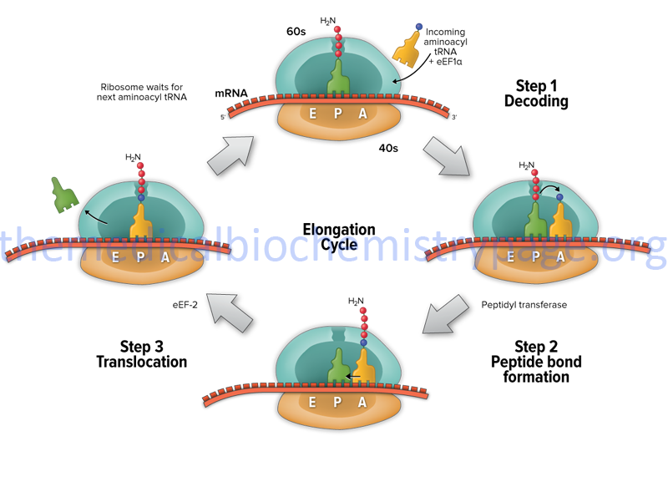

Slide 21
Site and mode of action | Spectrum |  |  | Antibiotics (inhibiting translation & transcription)
 | P&E | E | P
Inhibits building of charged tRNA to A site |  |  | + | Tetracycline
Inhibits initiation of protein synthesis |  |  | + | Streptomycin
Inhibits peptidyl transferase |  |  | + | Chloramphenicol
Inhibits translocation |  |  | + | Erythromycin
Block transcription initiation by binding RNA polymerase |  |  | + | Rifampicin
Inhibits peptidyl transferase |  | + |  | Cycloheximide
Inhibits mRNA synthesis |  | + |  | α-Amanitin (mushrum)
Premature termination of polypeptide | + |  |  | Puromycin
Binds to DNA blocking RNA polymerase movement | + |  |  | Actinomycin D

Slide 23
Toxin | Action
Diphtheria toxins | Catalyzes ADP ribosylation EF2 (prevent translocation )
Ricin | Castor oil inactivates 60s subunit
Cycloheximide | Inhibits eukaryotic peptidyl transferase
Interferon | Stop initiation of protein synthesis (inhibits viral reproduction)

Slide 24

Thank you

